Slide 1
Fundamental computer & emerging technologies
Devloped by :
Gadhiya yash ( 702 )
guide by : meghna panara

Slide 2
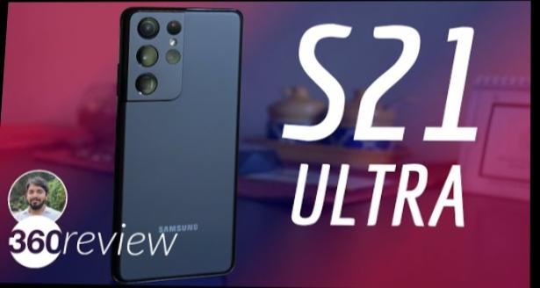
Samsung galaxy s21 ultra 5g
17.3 cm ( 6.8”) Screen size
227G weight
2.9 Ghz Max.cpu speed octa – core
108 mp wide,12mp wide,10m Felephoto (3x) 10m felephoto (10)
max.zoom up to 100 X
40 mp front camara
5000 mAH battery
128gb/256gb/512gb storage

Slide 3
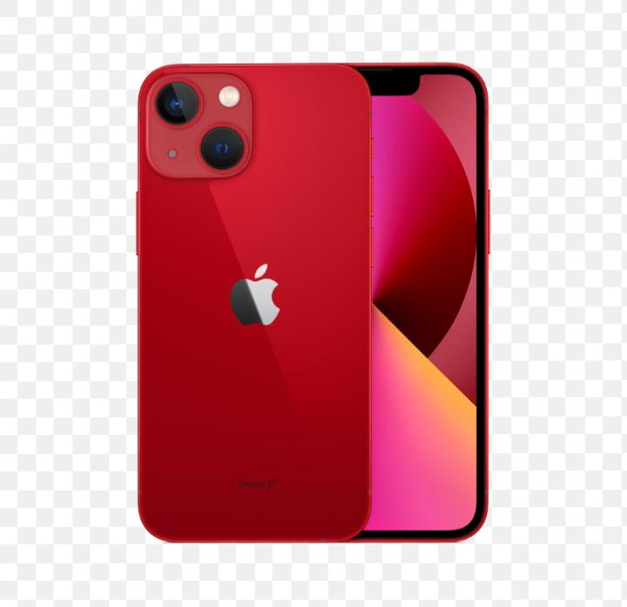
Apple 13 Mini
5.4” Super retina display
A15 Dual Bionic chips etc.
12mp Dual rear camera
128gb/ 156gb & 512gb storage

Slide 4
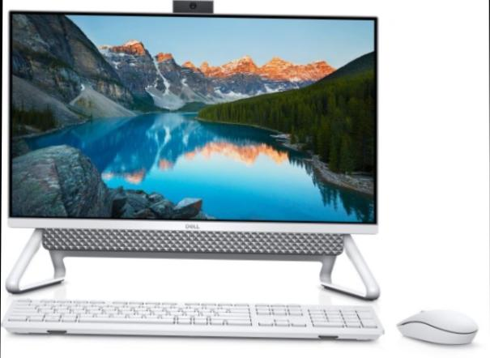
Dell Inspiron 24 5400
Series :-Inspiron
Brand :-Dell
Specific user for product :- student
Screen size :- 23 inches
Processer count :- 1
Hard disk size :-256 GB
Connectivity tecnology :-USB,Ethernet,HDML

Slide 5
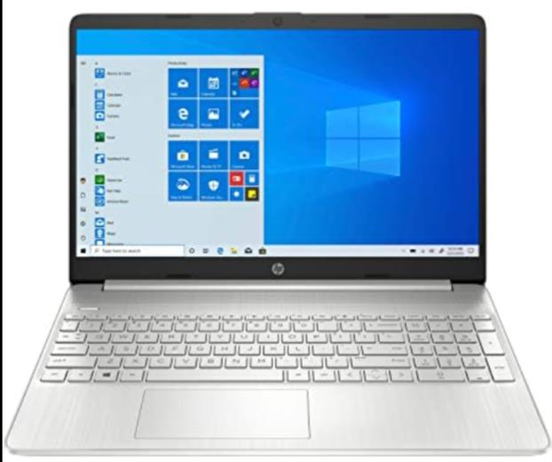
HP 15s 11th Gen intel core i3
Model name. . :- 15s-du3564TU
Brand. :- HP
Specific User For Product. :- Multimedia,student, business
Screen size :- 39.6 centimetres
Operating system. :- windows 11 Home
CPU manufacturer. :- Intel
Connecter Type. :- Bluetooth,WIFI

Slide 6
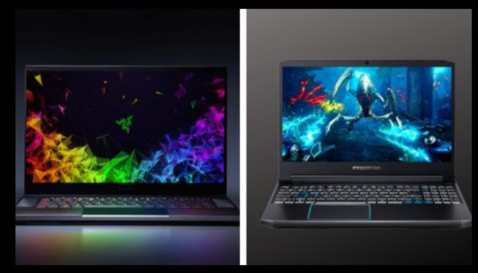
Best gaming experience in laptop
Gaming Aspire 7 5800h & predator
Acer nitro 5 gaming laptop ( AMD recently 7 5800h/16gb/256gb ssd / 1 fb HHD / NVIDIA.
Geforce RTX 3050TI Graphics / windows 10 home )|ANS 15 45 with 39.6cm ( 15.6 inch ) IPS FHD display

Slide 7
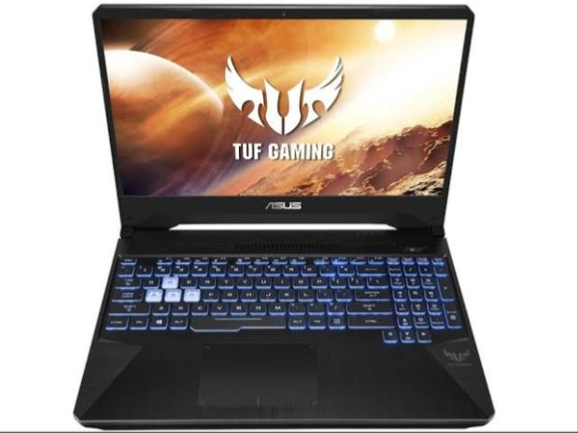
Second gaming laptop
Personal computer design type – ALL IN ONE
Specific user for product – MULTIMEDIA
Model name – Imac
RAM – 8 GB
Operating system – Mas OS
CPU model – APPLE M1
Screen size - 24 inches
Brand – APPLE

